Slide 1
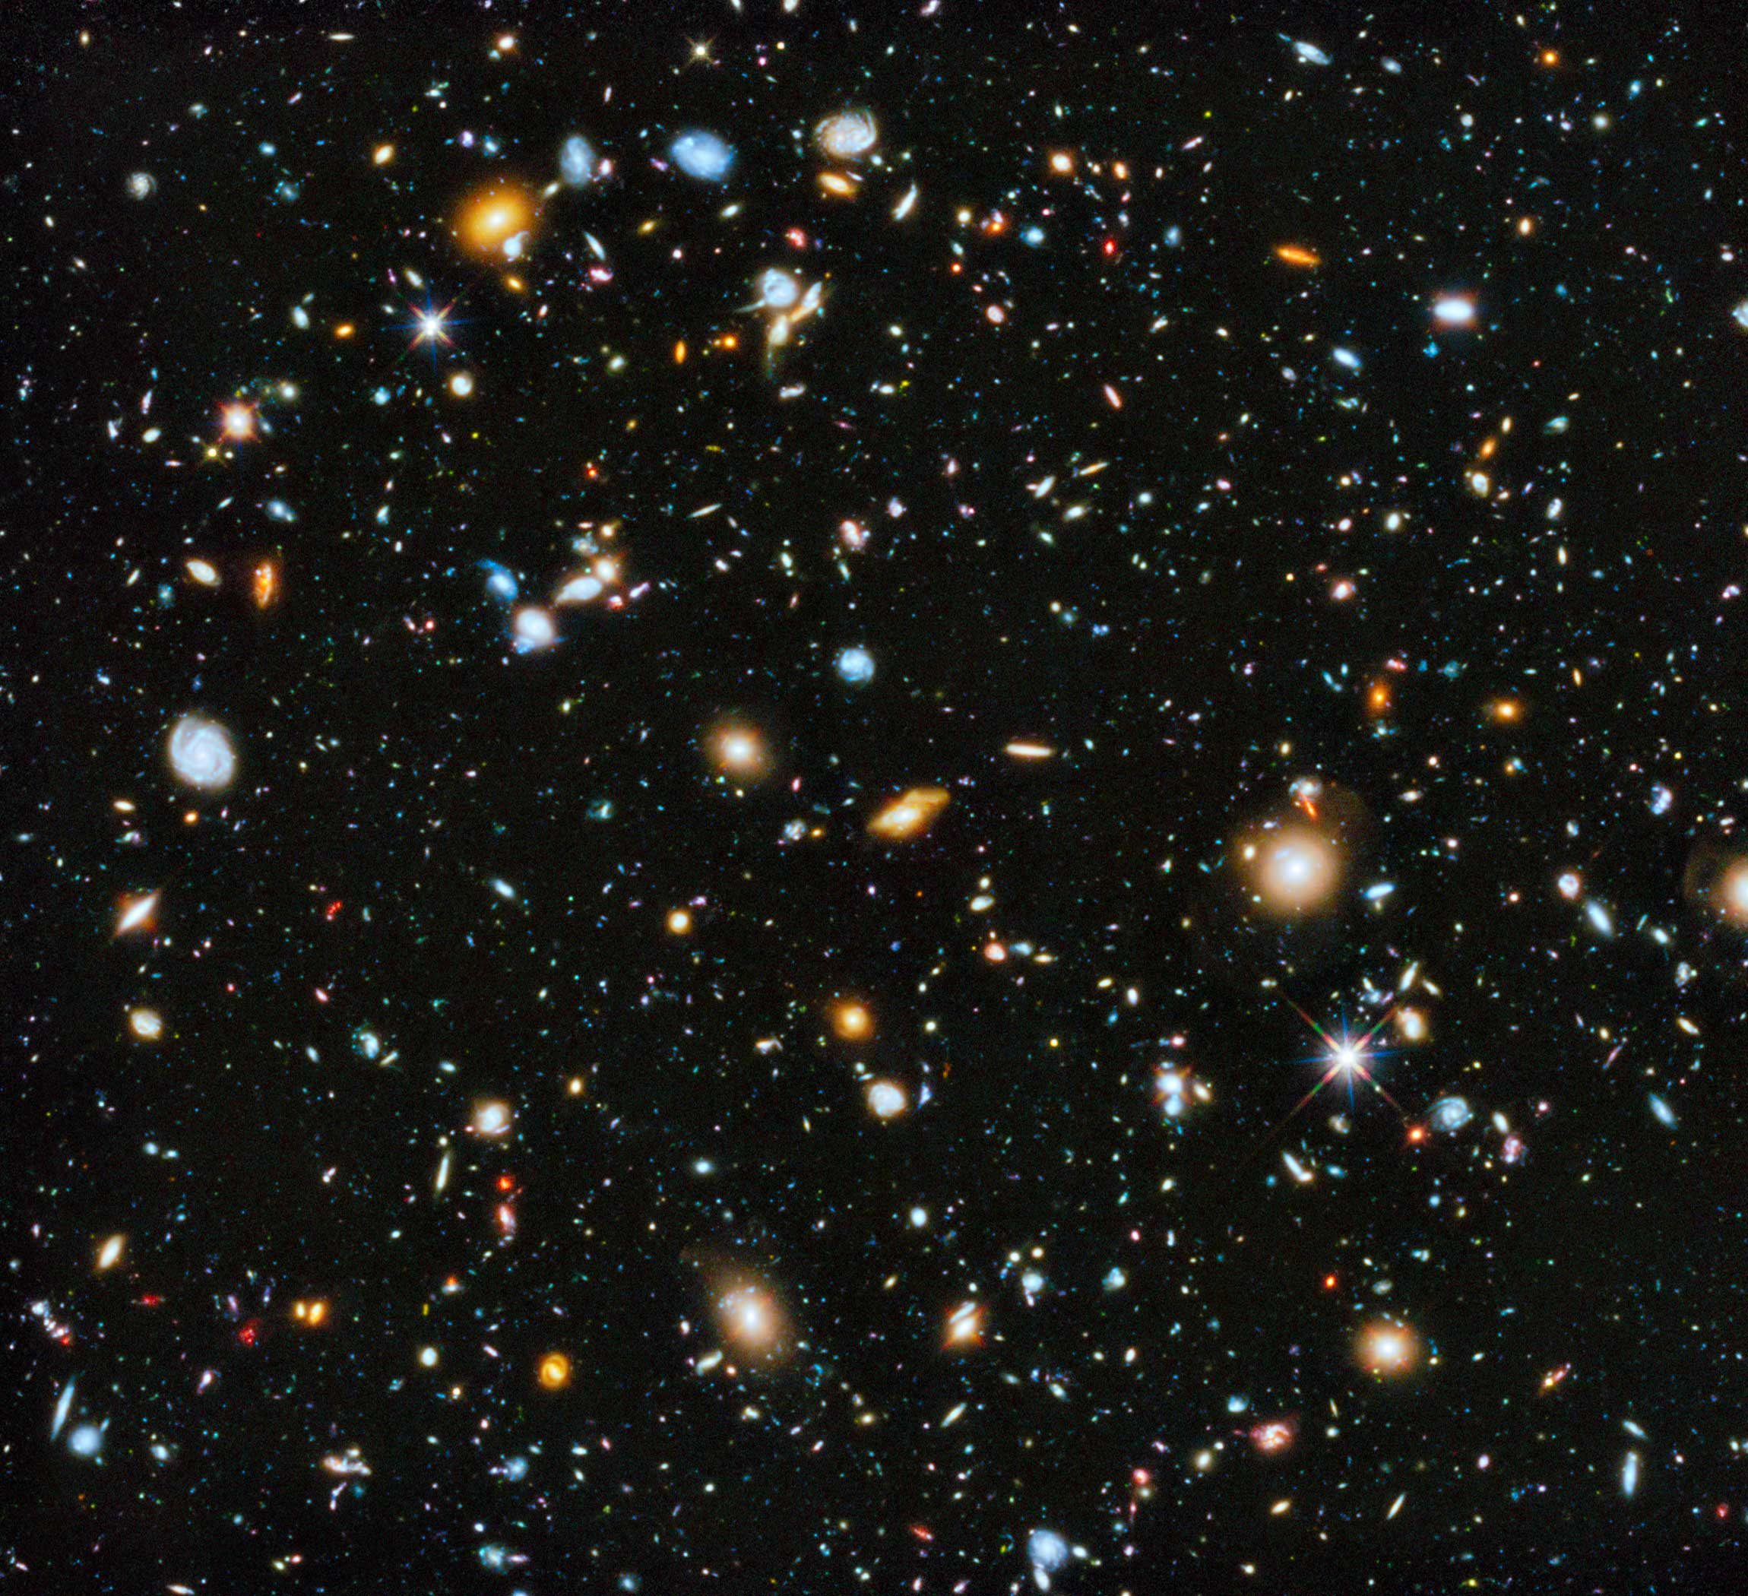
SDSS Classification
Diego McDonald

Slide 2
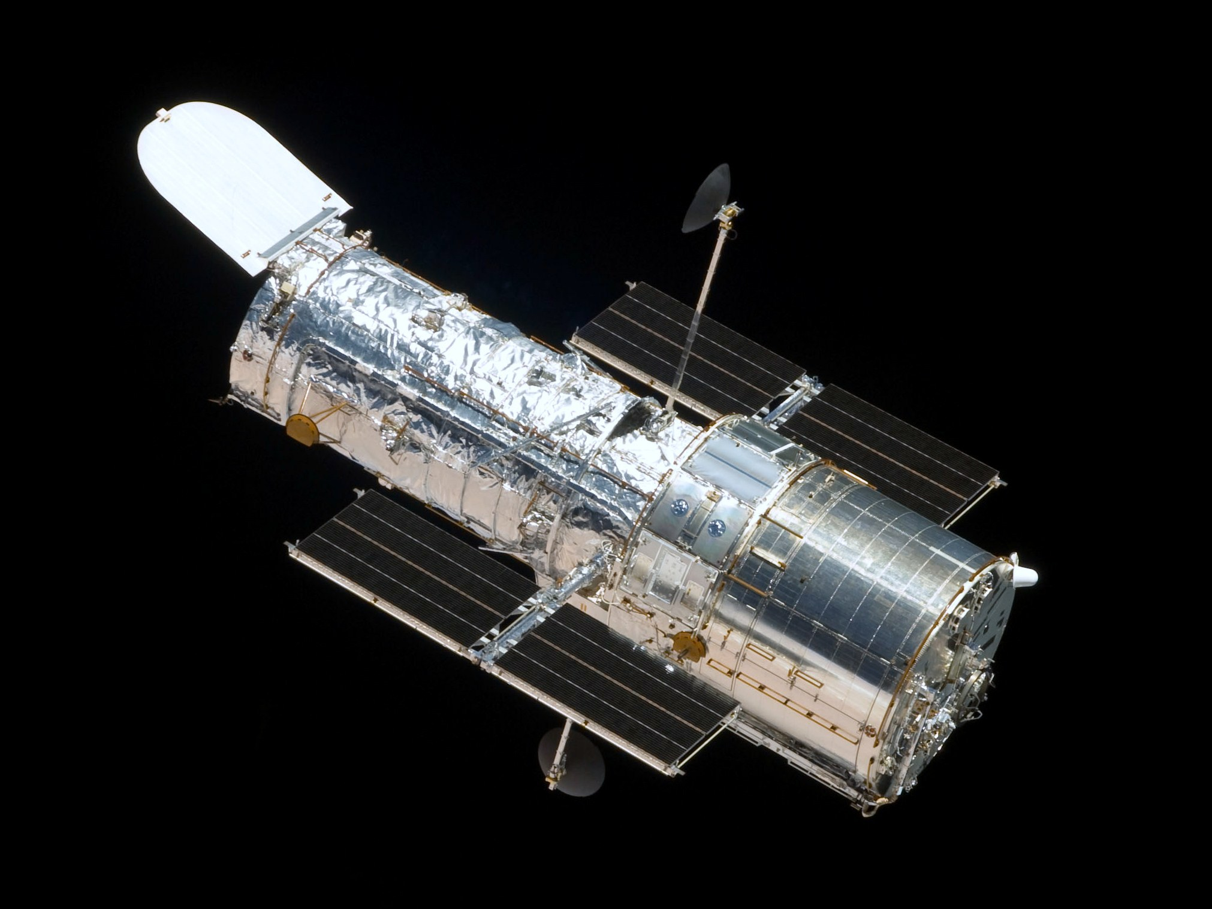
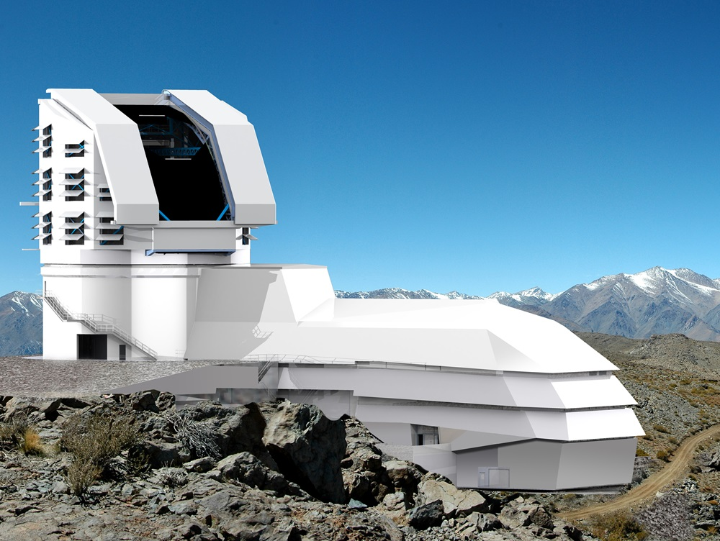
Problem Statement
Notes:
Changes from Telescopes seeing very dim to seeing very wide.
Left – Hubble Space Telescope
18GB/week average
LSST (https://astronomy.com/news/2017/12/the-lsst-and-big-data-science) and (https://www.lsst.org/about)
20TB processed and stored each night
Planned to deliver over 500 PetaBytes

Slide 3
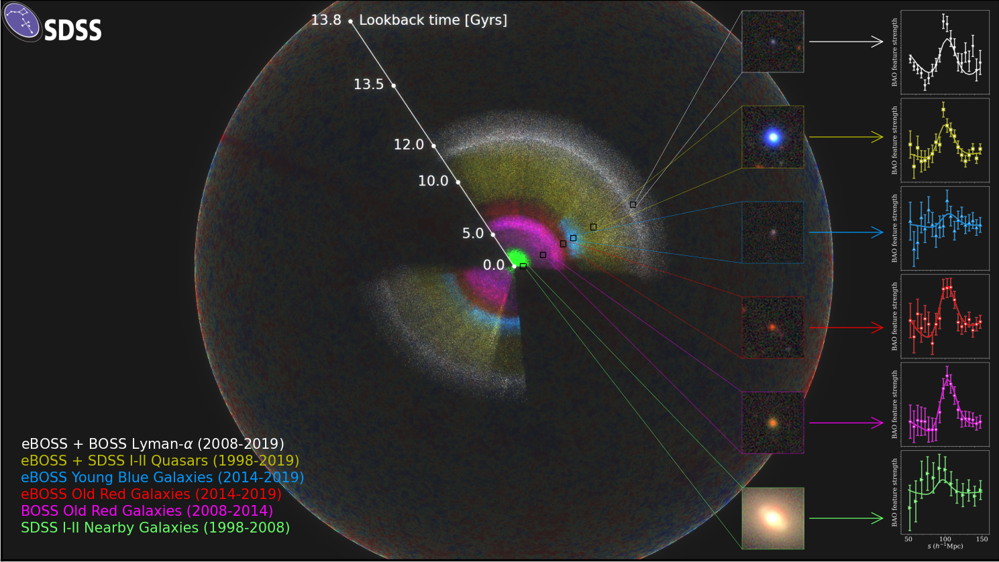
Objective
Notes:
SDSS
Lots to look at
Most important features
Each point is an observation
Each color is how far back in time we are looking
The further back we look, we are able to see more “creation” → younger galaxies
Data
230 million objects
>270 TB

Slide 4
Datasets

Slide 5
Block Diagram

Slide 6
Methodology

Slide 7
Baseline (Success or Failure)

Slide 8
Evaluation

